Slide 1


Capstone PRESENTATION
Marcos Garcia
Data Analyst

Slide 2

About the Capstone Project
The objective of the project is to demonstrate my ability to use Python, Tableau and SQL technologies through different business scenarios.
Python (TMDB Movies Data)
Tableau (Churn Bank Data)
SQL (Sakila Movie Rental).

Slide 3





THE DATA
TMDB Movies
Churn Bank
Sakila Rental
Dataset consisting of over 4000 movies with detailed information
Analyze a movie dataset to identify what kinds of movies perform well in cinemas and to identify which genres they belong to
Consisting of over 10k clients, banking information across 4 different English regions
Analyze the churn dataset to help the bank evaluate the customers who have stopped purchasing credit card of the bank. Find measures to reduce the banks loss rate
They are a chain of movie rental stores. Consists of numerous tables which includes extensive information like movies, customers, rentals, actors etc
Analyze what kind of movies are most often rented, which genres they belong to, and which actors appear in them

Slide 4

TMDB Movies Python
How you chose the imputation method to deal with missing values
How you performed outlier analysis
How you identified a correlation between popular movies and movie budgets

Slide 5
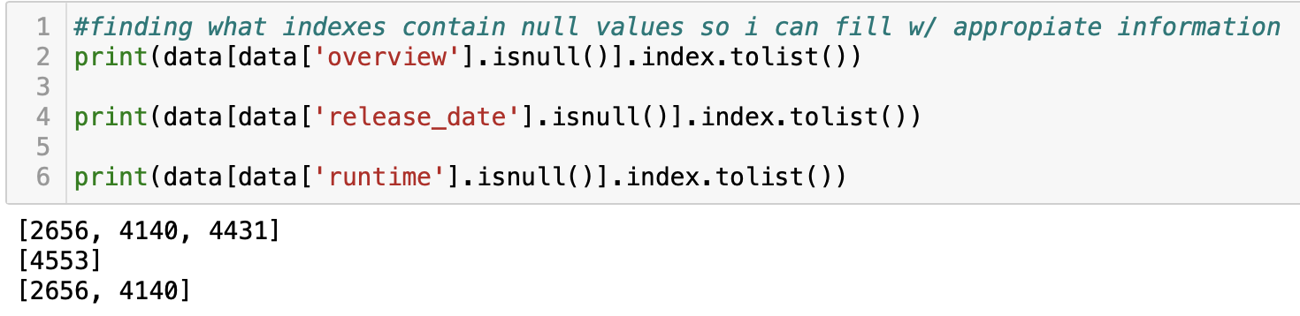
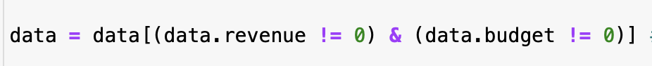
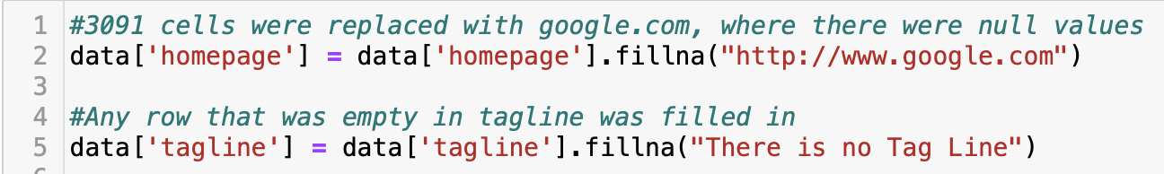
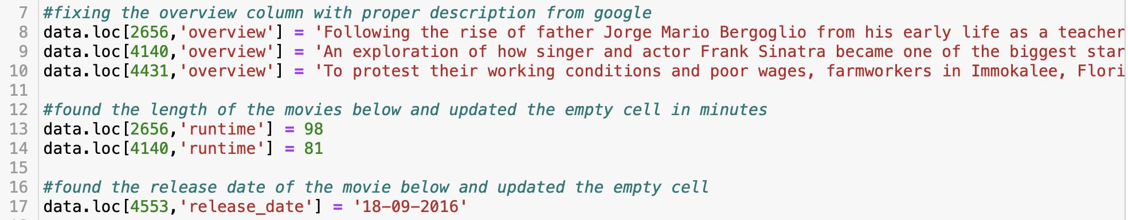
Data Cleaning Choosing the imputation method
Filtering to drop rows Filtering for values you don’t need and setting it to the same data frame
Finding the exact empty index in a column Returns a list of indices in each the specific column
.fillna() function Fills empty values in any row and with any info
.loc[index #, ’column name’] updating a specific cell in the data

Slide 6
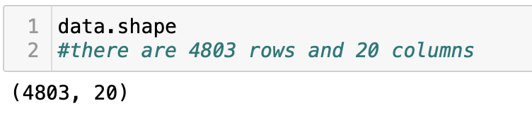
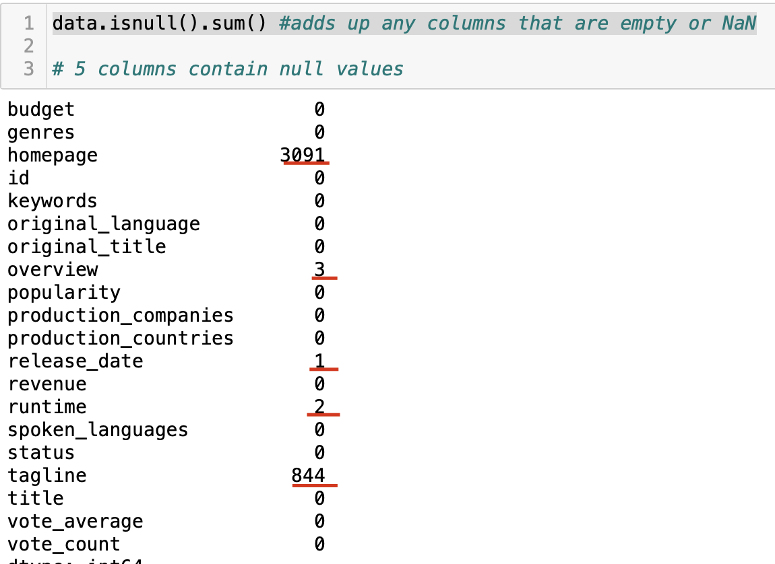
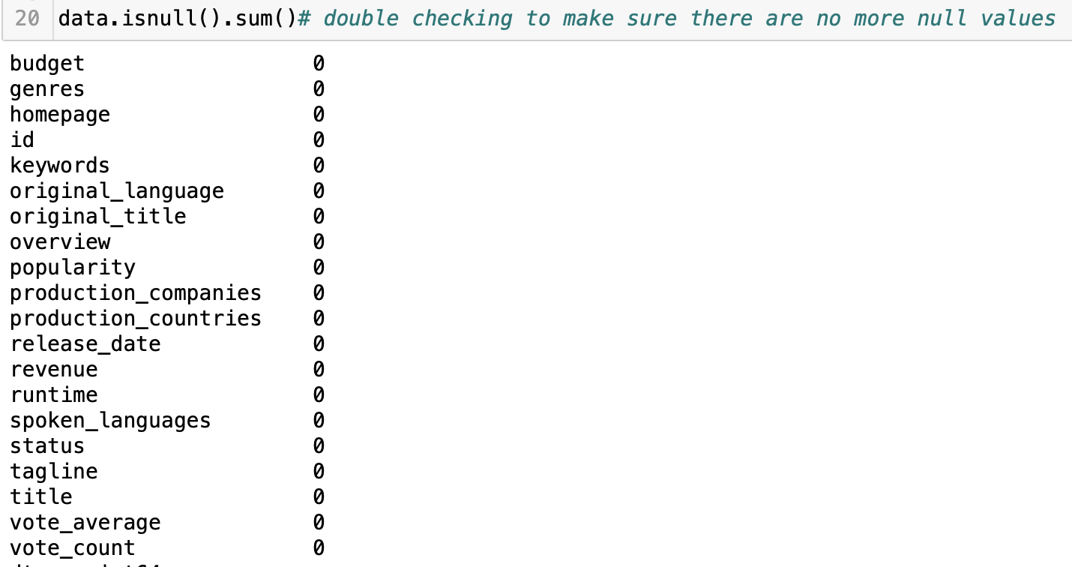
Data Cleaning Choosing the imputation method
.shape function determines the size of the data.
.isnull().sum() function adds up any empty or NaN columns and displays it

Slide 7
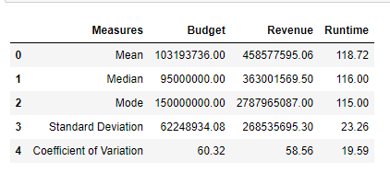
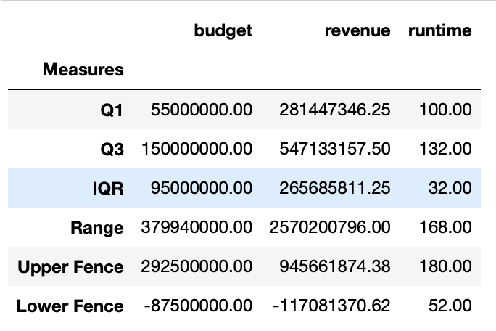
Statistical Analysis Data Frames
Analyzed the budget, revenue and runtime columns
Found the mean, median, mode, standard deviation, coefficient of variation, 1st and 3rd quartile, inter quartile range(IQR), Range,Upper and Lower Fence
Used for loops to iterate through the columns, created lists to store these values, and then created a data frame with all the lists

Slide 8
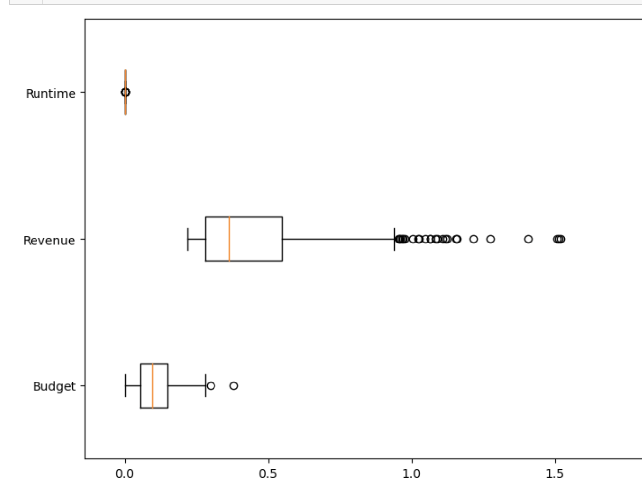
Outlier Analysis Box Plot
Created box plots for the budget, revenue and runtime columns using matplot
No outliers in the Runtime column
Revenue column contained a lot of outliers
The budget column contained two outliers

Slide 9
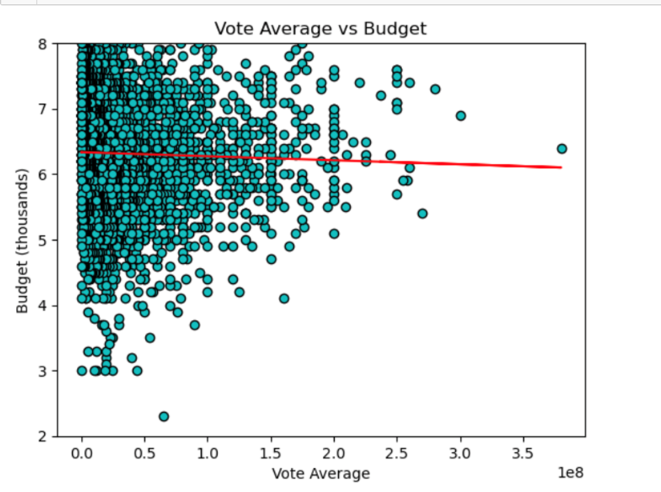
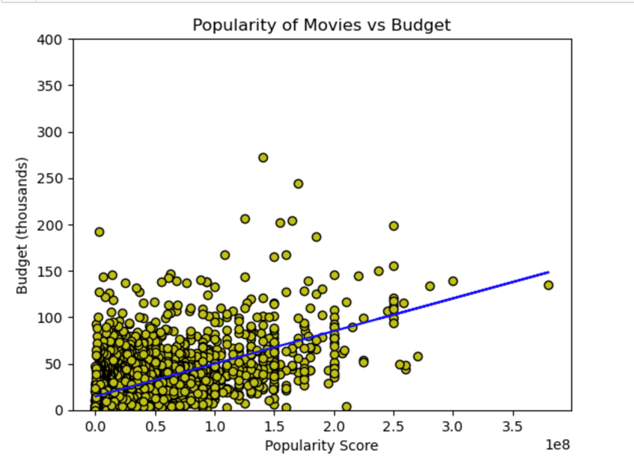
Correlation
Created two scatter plots using matplot and seaborn (view code)
Looked for correlation between Voting Average and Budget (slight negative to no correlation)
Looked for correlation between Voting Average and Budget (some positive correlation)
Added a trendline for easier view of any correlation

Slide 10
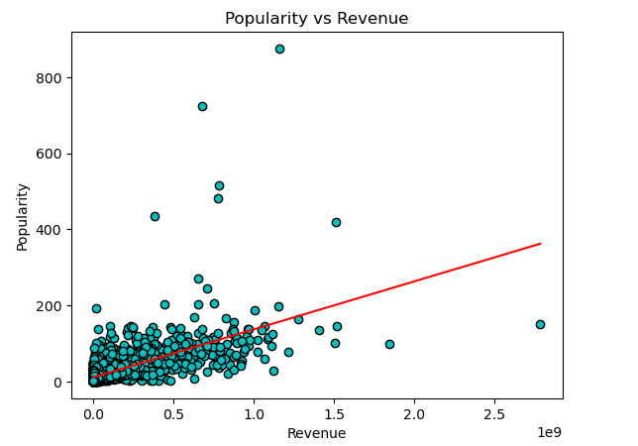
Key Findings The Problem: Identify what kinds of movies perform well in cinemas and identify which genres they belong to
There is a noticeable positive correlation between the movie budget and popularity score
There is a strong positive correlation between the movie revenue and popularity score
No correlation between voting average and budget
The most popular genres were action and adventure
The most popular genres were action and adventure

Slide 11
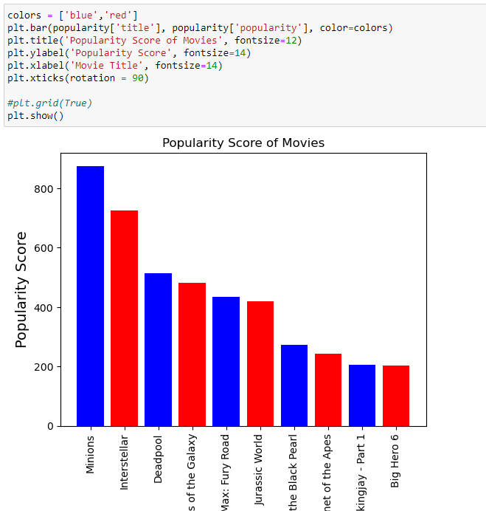
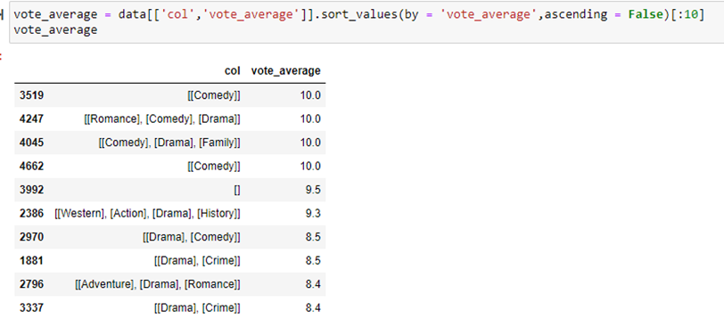
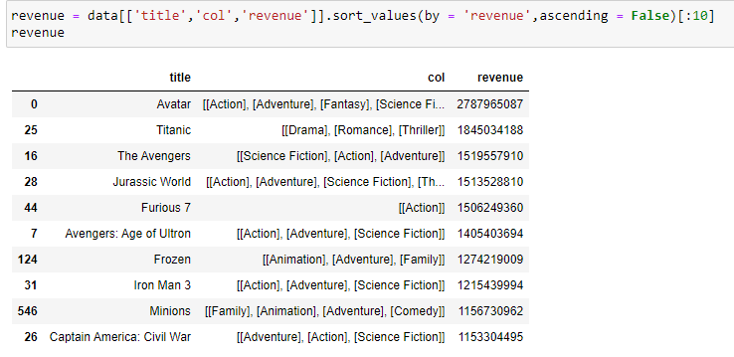
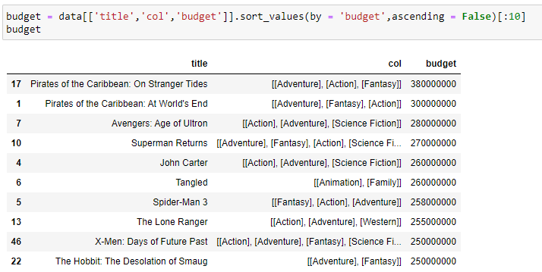
Key Findings The Problem: Identify what kinds of movies perform well in cinemas and identify which genres they belong to
Minions – Highest popularity Score
Comedy and Drama had the best Voting Average
Pirates and the Caribbean – Highest Budget
Avatar – Highest Revenue

Slide 12

Churn Bank Tableau
How I performed data preprocessing with python
How I created a template for the dashboard
How I add interactivity using visuals and filters

Slide 13
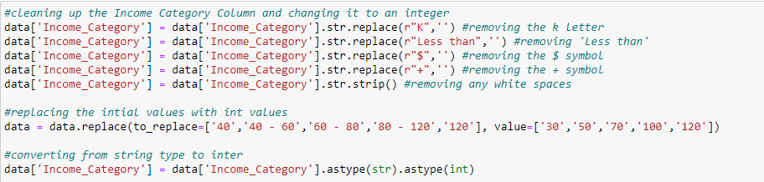
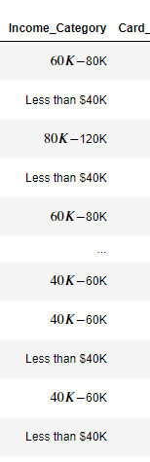
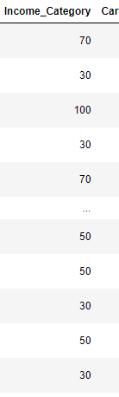
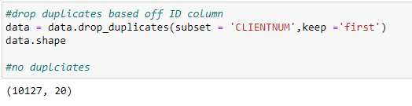
Data Cleaning
Filtering to drop rows Filtering for values you don’t need and setting it to the same data frame
Cleaning up columns
Cleaned up the Income Category column with string,integer and special characters
.drop_duplicates function Drops any duplicates in the dataset or specified column
13

Slide 14
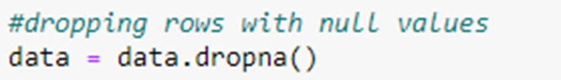
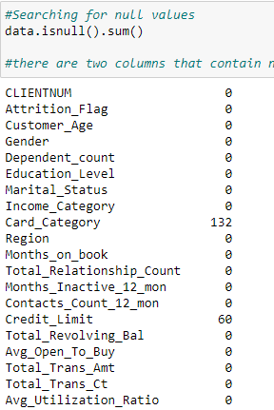
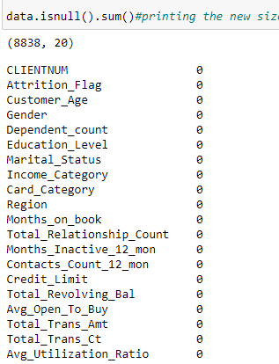
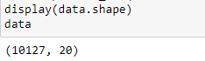
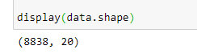
Data Cleaning Choosing the imputation method
.isnull().sum() function adds up any empty or NaN columns and displays it
.dropna() function This drops any rows with null values but in this case,
it removed the rows in the Card Category and Credit Limit columns with null values
.shape function determines the size of the data.

Slide 15

Creating a Template Figma
Creatied a very simple but effective layout
shape sizes were based off the type of charts I would be using
Wanted to create a ‘click’ effect so I made the left side darker as a home screen type of image

Slide 16
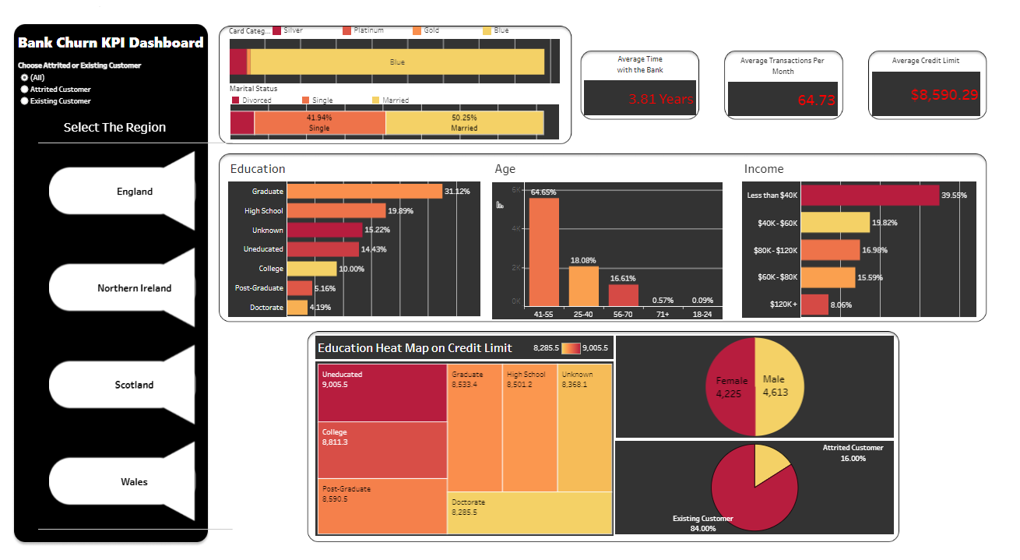
Dashboard Adding interactivity
Added a filter between existing and non existing customers that is synced with the rest of the graphs
Created icon buttons with an action filter that are applied to all worksheets
The dashboard is categorized by region
Used bar graphs, pie charts, stacked charts, and heat maps

Slide 17
Key Findings The problem: Find measures to reduce the banks loss rate
There is a huge number of users with a blue card and almost no platinum or gold card members
No real correlation between:
Education level and Credit Limit
Card Category and Credit Limit
Credit Limit and Age
Card category and Age
Credit Limit and Income Category
Income Category and Credit Limit
Suggestions
Promote more benefits to the top-tier cards (Gold and Platinum)
Offer higher tier cards to those with a higher education or higher income
Cap the credit limit for each card category (especially blue card), so members can upgrade
Require higher tier cards with no downside after being with the bank a certain amount of years

Slide 18

Sakila Rental SQL
Basic queries
Using joins/Group/order by
help the management stock up the inventory for improved business
analyze what kind of movies/genres are most often rented

Slide 19
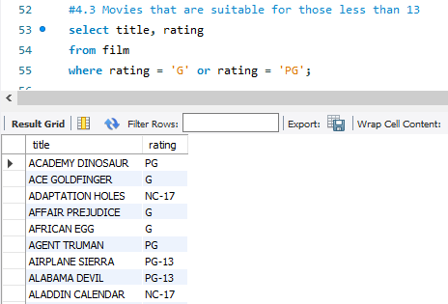
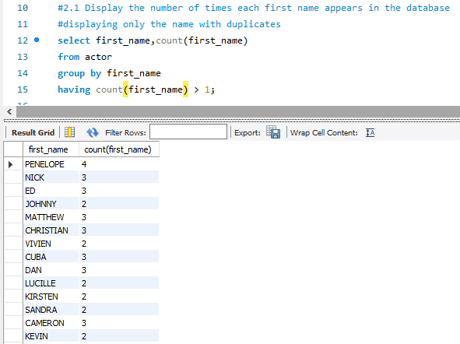
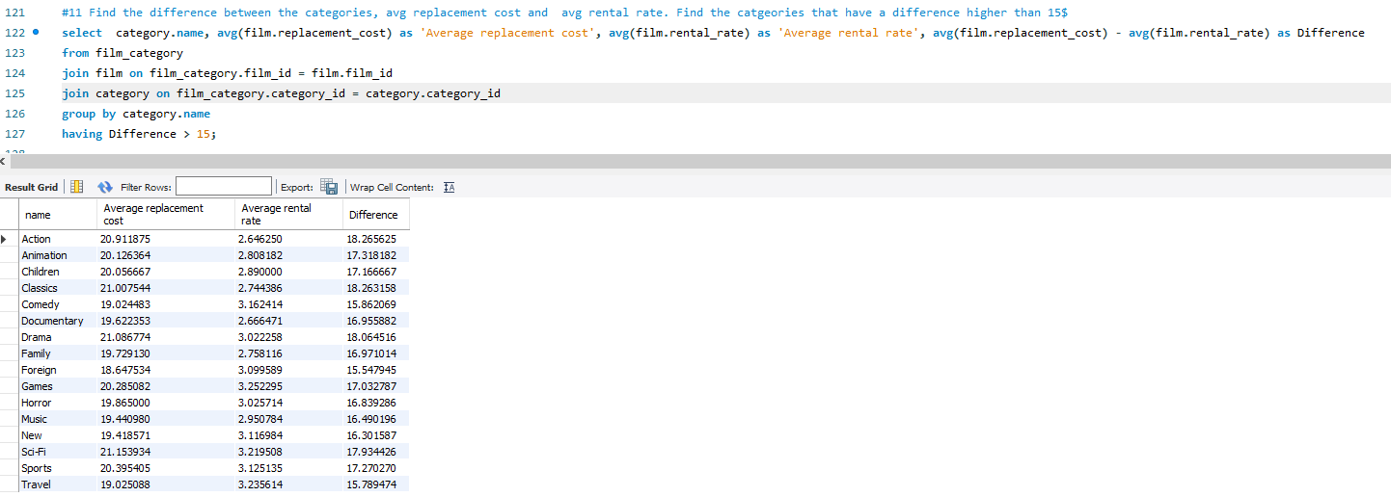
Basic Queries Getting to know the data
Queried the data to get familiar with the movies and actors
Used basic arithmetic operations to search for duplicates and to get the difference in rates
Filtered the data with ‘where’ and ‘having’ statements
Used aliases

Slide 20
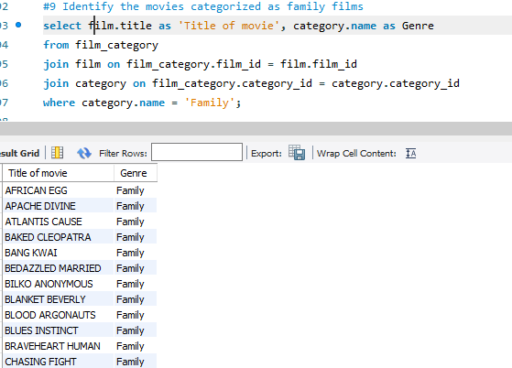
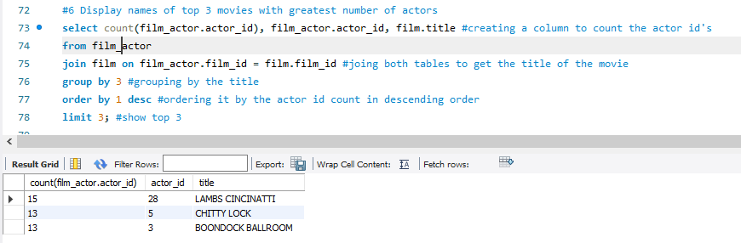
Using Joins and Group/Order By
Used joins to combine tables and find the movies for families
Grouped the data by the movie title to get a count of movies with the most actors
Used order by statements to organize data in ascending or descending order

Slide 21
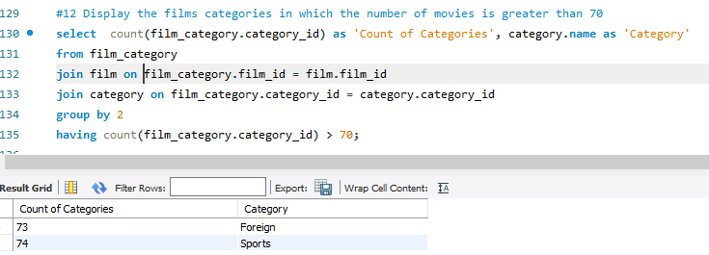
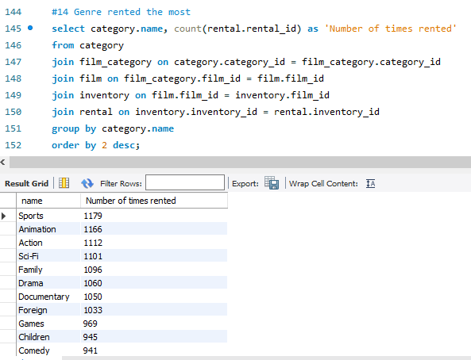
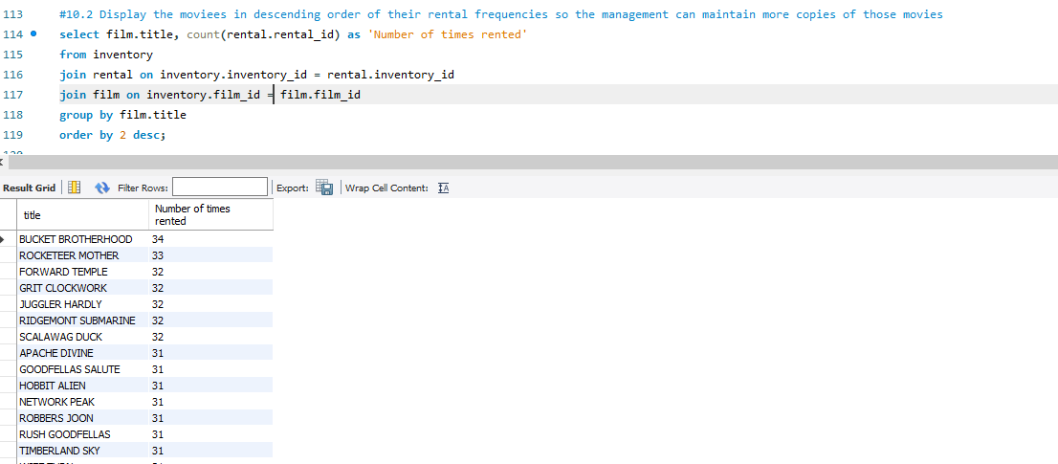
Inventory Help the management stock up the inventory for improved business
Foreign and Sports have the highest count
The movie ‘Bucket Brotherhood’ was the highest
rented movie
Sports and Animation were the most
rented genres

Slide 22





Thank You
Marcos Garcia
914-708-6070
marcosx1099@gmail.com
www.linkedin.com/in/marcosx1099/
public.tableau.com/app/profile/marcos.antonio.garcia
www.github.com/marcosx1099

